Slide 1
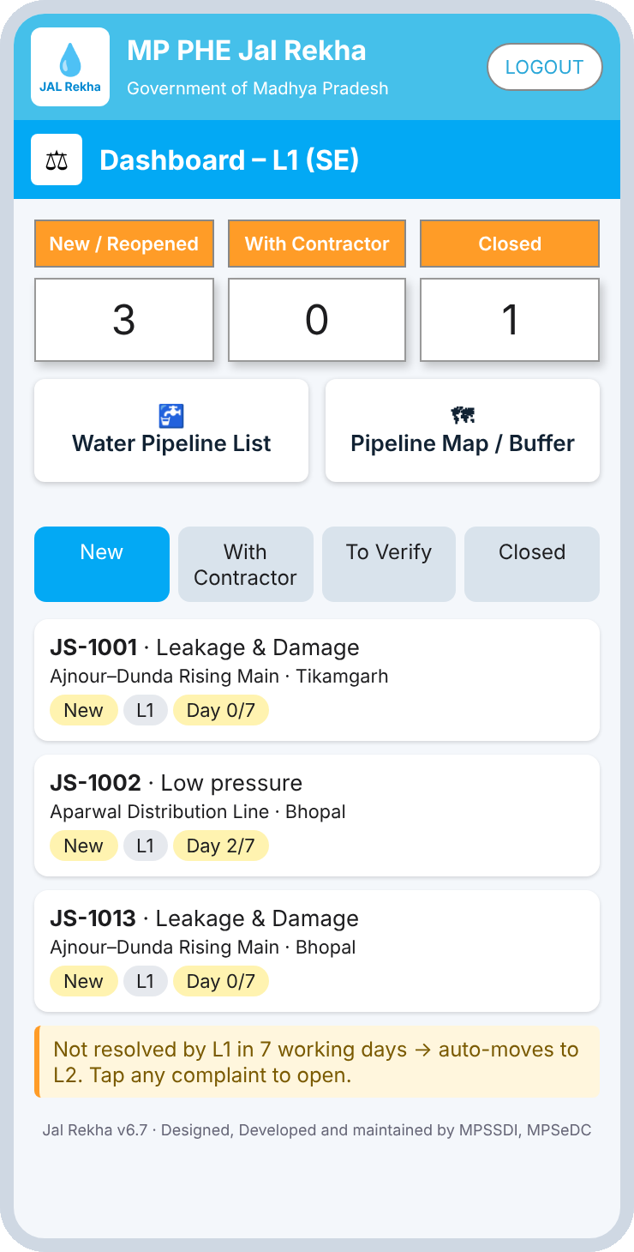
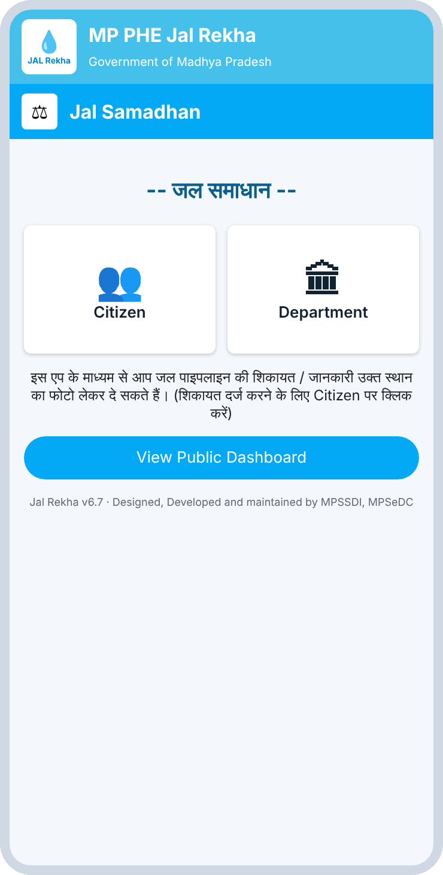
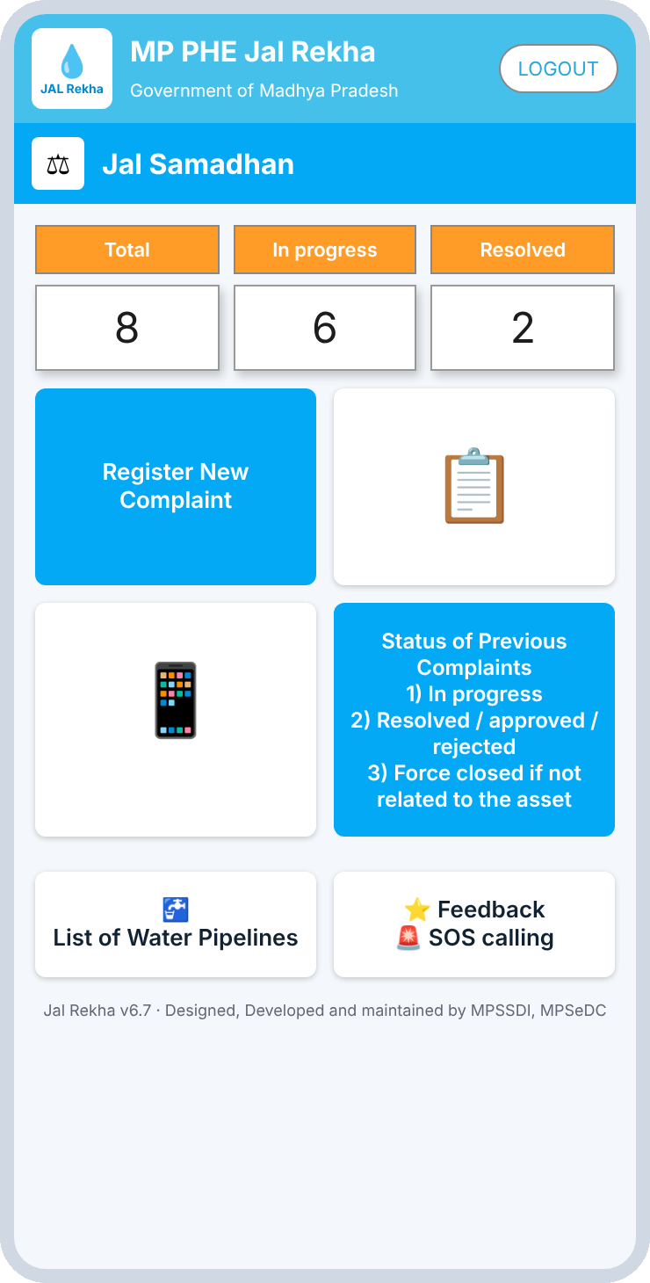
Jal Samadhan
Water pipeline grievance redressal: interactive wireframe walkthrough
MP PHE Jal Rekha · MPSeDC · Wireframe v3
Notes:
Walkthrough of the Jal Samadhan interactive wireframe (v3): every screen, every role, and the complete complaint flow from citizen to L3 monitoring.

Slide 2



What Jal Samadhan does
Citizens report
18
5
Leakage, low pressure, no supply, contamination or burst pipes, with geo-tagged photo or video.
wireframe screens
user roles
Officers resolve
L1 (SE) assigns to a contractor or resolves personally. Contractors fix and upload proof.
7
2
Seniors monitor
Unresolved complaints move up after 7 working days. L3 (EE) verifies, reopens or force-closes.
working days per level
platforms: mobile and web
Notes:
Jal Samadhan lets citizens report water pipeline problems with a geo-tagged photo; officers resolve them and senior officers monitor and escalate.

Slide 3



Who uses it
Public
Citizen (mobile)
L0 Contractor (mobile)
No login. Aggregate, non-personal dashboard: totals, district-wise counts, resolved list and pipeline map.
Registers with mobile and OTP, raises complaints with photo or video, tracks status, gives feedback, uses SOS.
Verified by registered mobile number. Resolves assigned complaints with an after-repair photo and remark.
L1 SE (mobile)
L2 AE (mobile)
L3 EE (web + mobile)
First-line officer. Assigns to a contractor or resolves personally; verifies and closes contractor work.
Receives complaints L1 has not resolved in 7 working days. Same actions as L1.
Monitors every district. Verifies completed work, reopens to L1, or directs L1 to force close.
Notes:
Six entry roles. L0 to L3 sit on the department side; Public needs no login.

Slide 4
The complete complaint flow
Main flow
via contractor
Citizen raises complaint
L1 (SE)
Assign to L0 (mobile verify)
L0 resolves (photo + remark)
L1 verifies & closes
L3 dashboard
Direct fix
L1 resolves himself
L1 (SE)
Resolves himself (photo + remark)
Closed
L3 dashboard
Escalation
every 7 working days
L1 not done in 7 days
L2 (AE)
Not done in 7 days
L3 (EE)
L3 actions
monitor and control
L3 (EE)
Verify
or
Reopen, back to L1
or
Direct L1 to force close
Notes:
Main flow goes through a contractor (L0). L1 can also resolve personally. Unresolved complaints escalate after 7 working days. L3 can verify, reopen or direct L1 to force close.

Slide 5
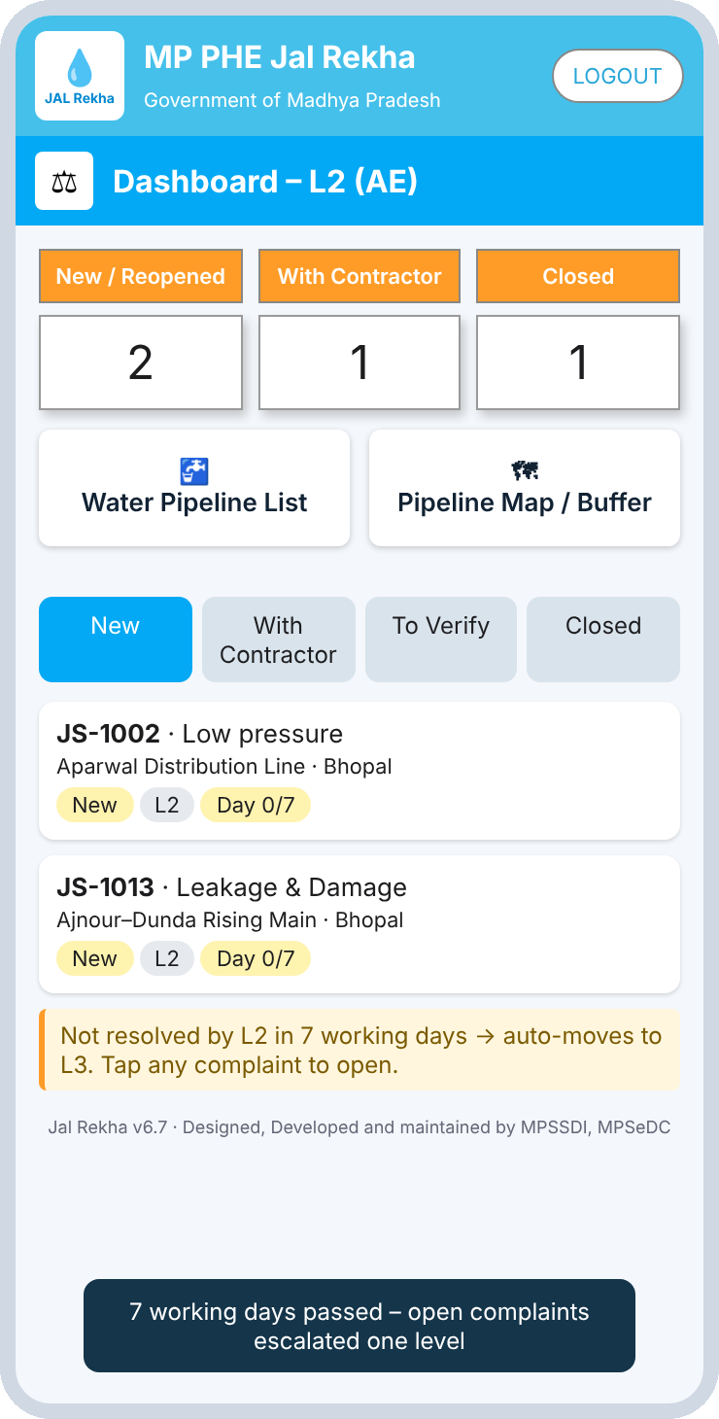
Escalation and oversight rules
L1 SE
7 working days
L2 AE
7 working days
L3 EE
Auto-escalation
Reopen
Force close
Open complaints not resolved in 7 working days move up one level and the day counter restarts.
L3 can reopen a completed complaint. It returns to L1 as Reopened with the age reset.
L3 directs L1 to force close complaints not related to the asset. The citizen sees them under Force closed.
After 7 working days
Simulated in the wireframe
Notes:
After 7 working days an open complaint moves up one level and its day counter restarts. L3 can reopen or direct a force close. The phone shows the L2 dashboard after the simulated 7-day jump.

Slide 6
Entry and citizen journey
SECTION A
From the landing page to raising and tracking a complaint on mobile.

Slide 7
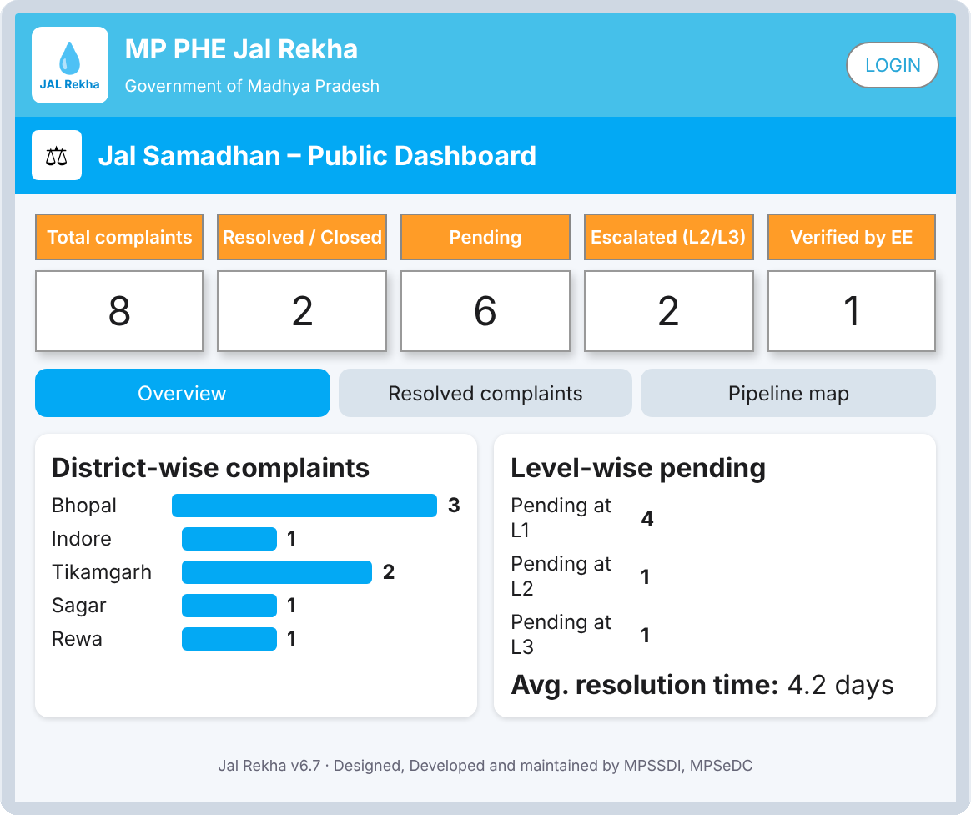
Entry points: landing and public dashboard
Public
What happens here
Landing page routes users to Citizen or Department login
Public dashboard needs no login and shows aggregate, non-personal data
Counters: total, resolved, pending, escalated (L2/L3), verified by EE
Tabs: overview charts, resolved list, pipeline map
Select user type
Public dashboard
Web, no login
Notes:
Landing page sends users to Citizen or Department login. The public dashboard needs no login and shows only aggregate data.

Slide 8
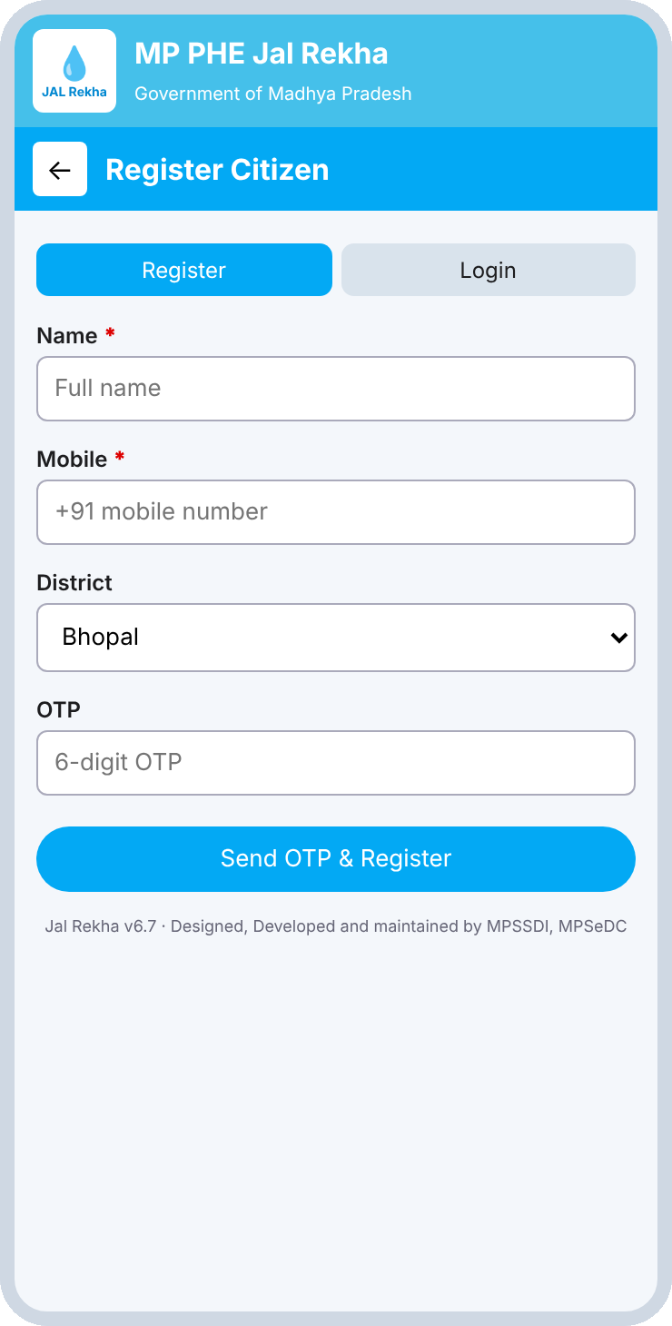
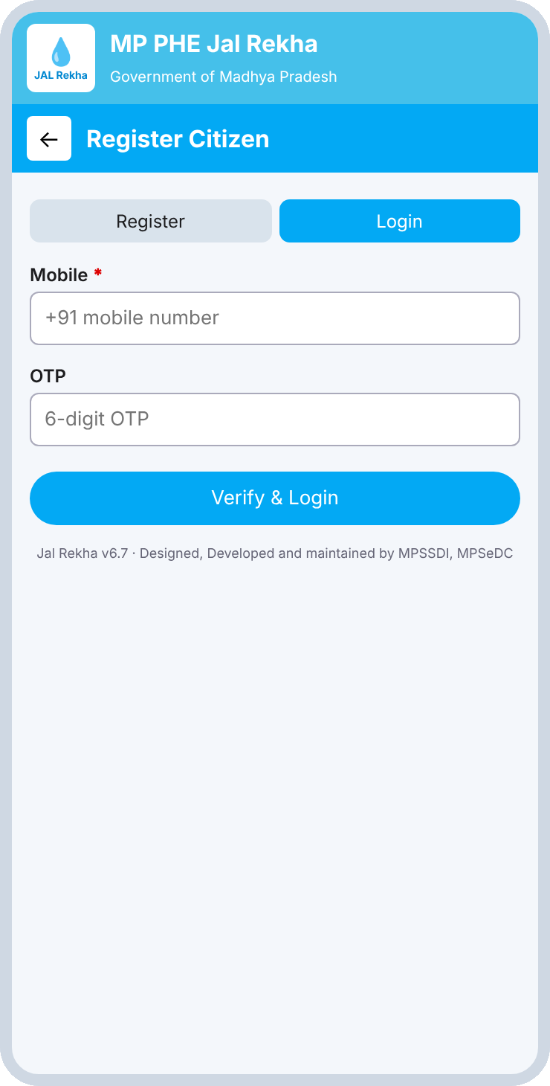
Citizen registration and login
Citizen
What happens here
Mobile number plus OTP, no password for citizens
First-time users register with name, mobile and district
Returning users verify and log in with an OTP
Success opens Citizen Home
Register tab
Login tab
Notes:
Citizens use mobile number and OTP. First-time users register.

Slide 9
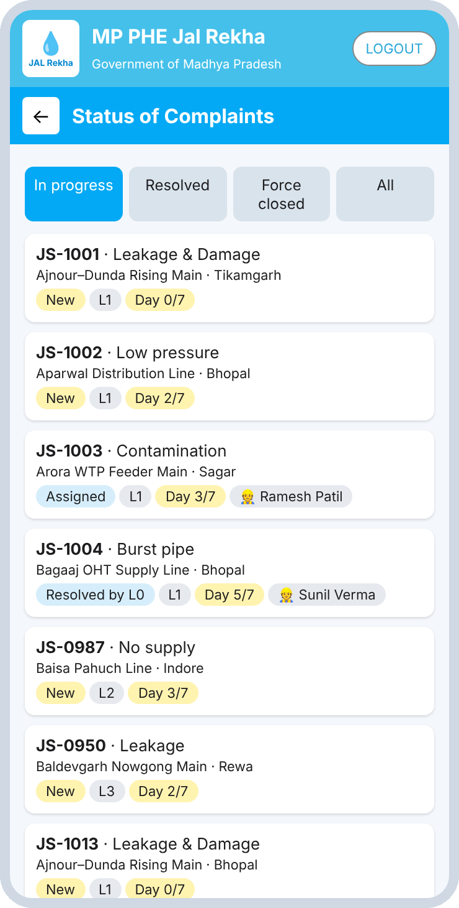
Citizen home and status tracking
Citizen
What happens here
Counters show Total, In progress and Resolved
Register New Complaint is the main tile
Status tabs: In progress, Resolved, Force closed, All
Force closed means not related to the asset
Shortcuts to pipeline list, Feedback and SOS
Citizen home
Status of complaints
Includes the new complaint
Notes:
Home screen shows counters and the main tiles. Status tabs filter live data.

Slide 10
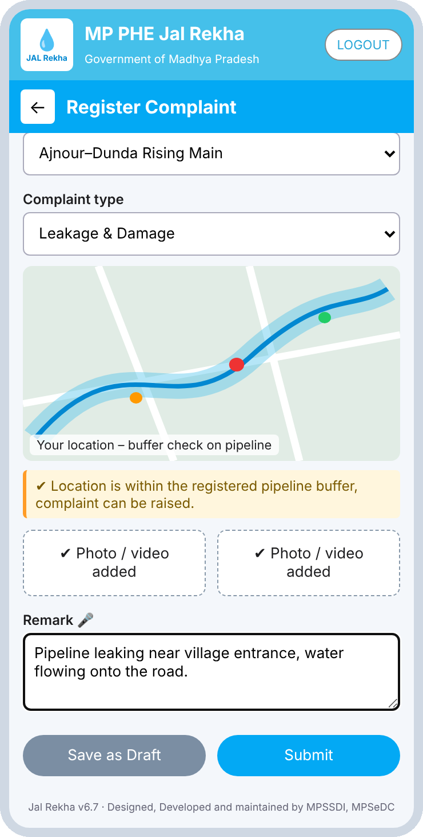
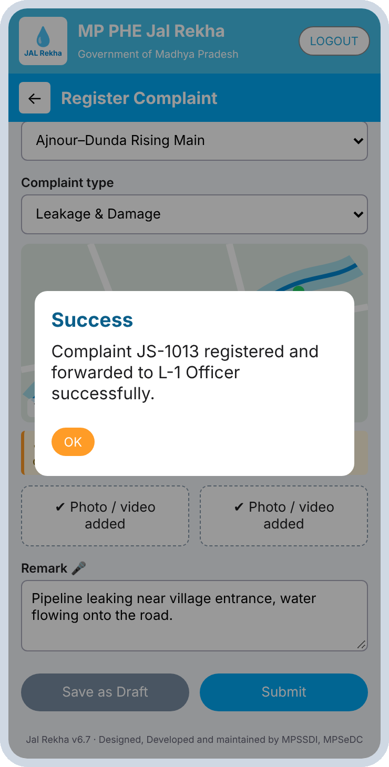
Registering a complaint
Citizen
What happens here
Pick district, block, gram panchayat and village
Choose the pipeline asset and complaint type
Map confirms the location is inside the pipeline buffer
Attach photos or video and a voice-enabled remark
Save as draft, or Submit: it goes straight to the L1 officer
Register new complaint
Submission confirmed
Notes:
Submit really adds a complaint to the L1 dashboard in the live demo.

Slide 11
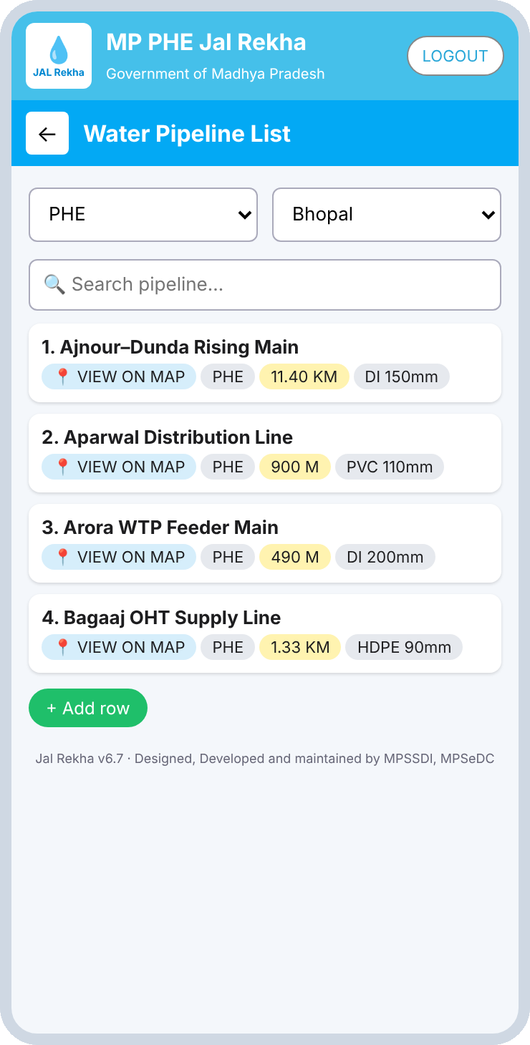
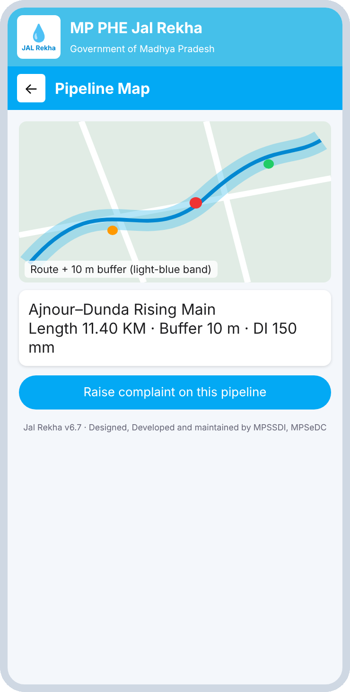
Pipeline assets and buffer map
Citizen
What happens here
Filter by department (PHE) and district, or search by name
Each row shows length and pipe spec, for example DI 150 mm
View on Map draws the route with a 10 m buffer
The buffer validates where a complaint can be raised
Raise a complaint directly from the map
Water pipeline list
Route and buffer map
Notes:
Replaces the road list of the road-complaint model with water pipeline assets.

Slide 12
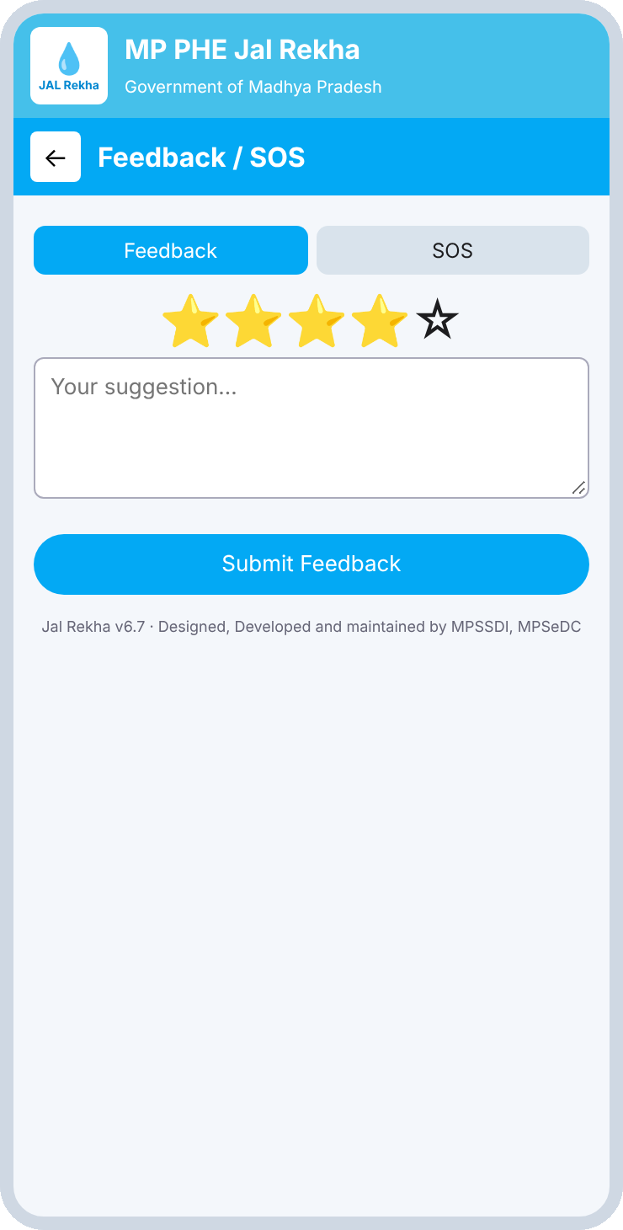
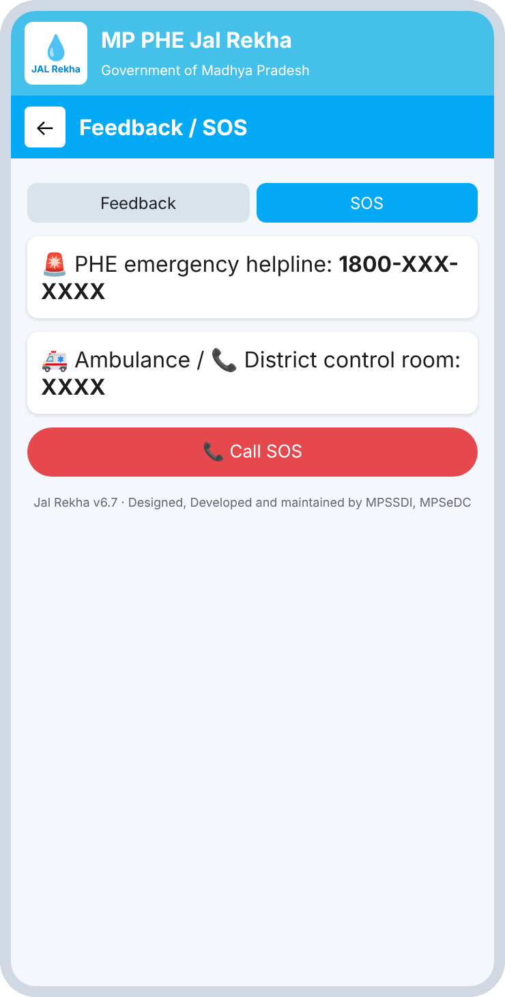
Feedback and SOS
Citizen
What happens here
Feedback: star rating plus a free-text suggestion
SOS: PHE emergency helpline and district control room
One-tap Call SOS button
Helpline numbers are placeholders in this version
Feedback tab
SOS tab
Notes:
Citizen support screens. SOS numbers are placeholders in this wireframe.

Slide 13
Department workflow
SECTION B
Contractor (L0), Superintending Engineer (L1) and Assistant Engineer (L2) on mobile.

Slide 14
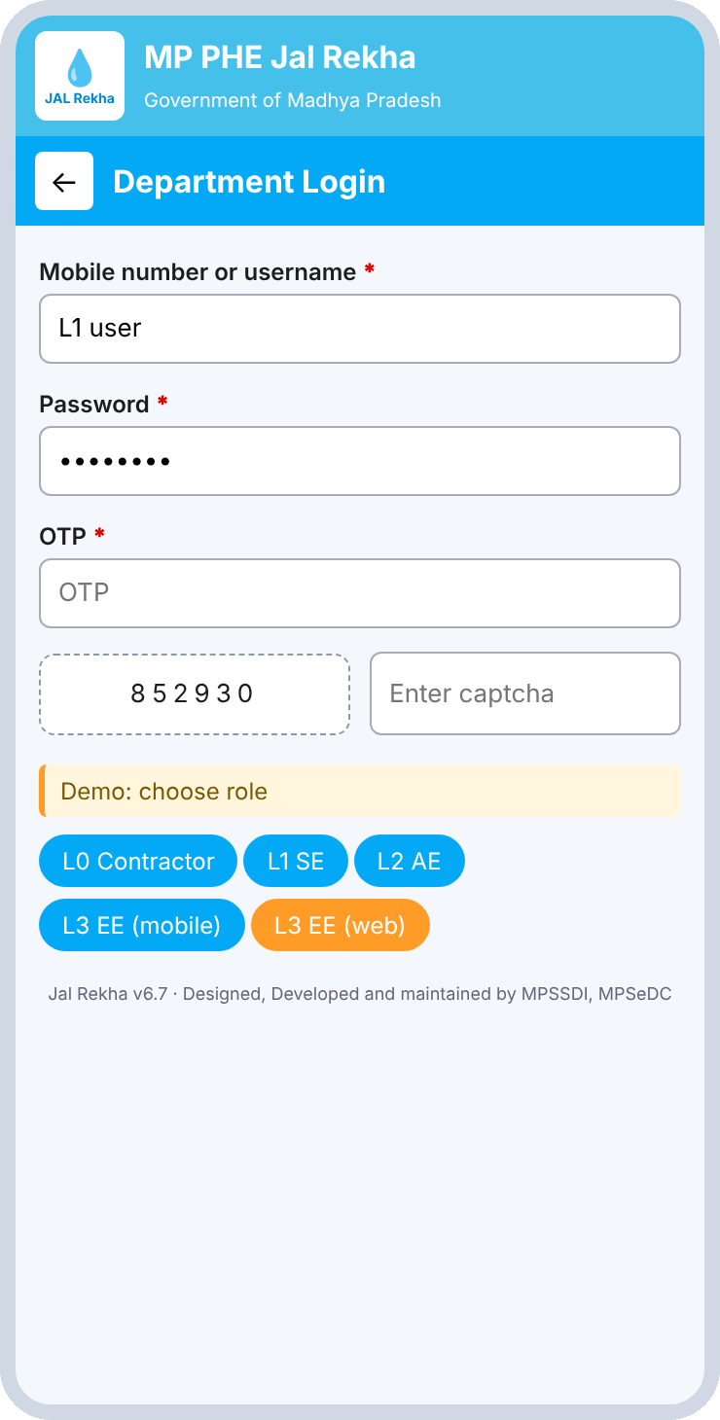
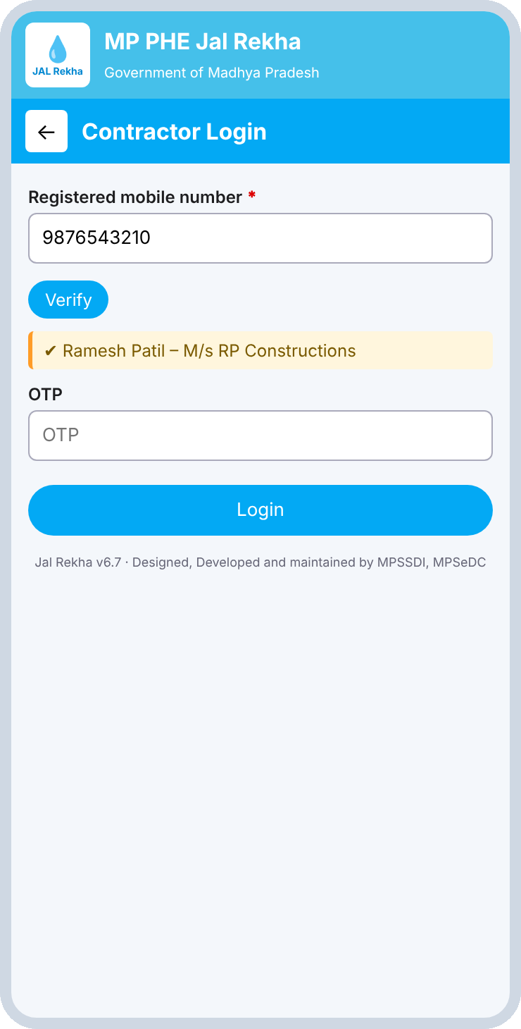
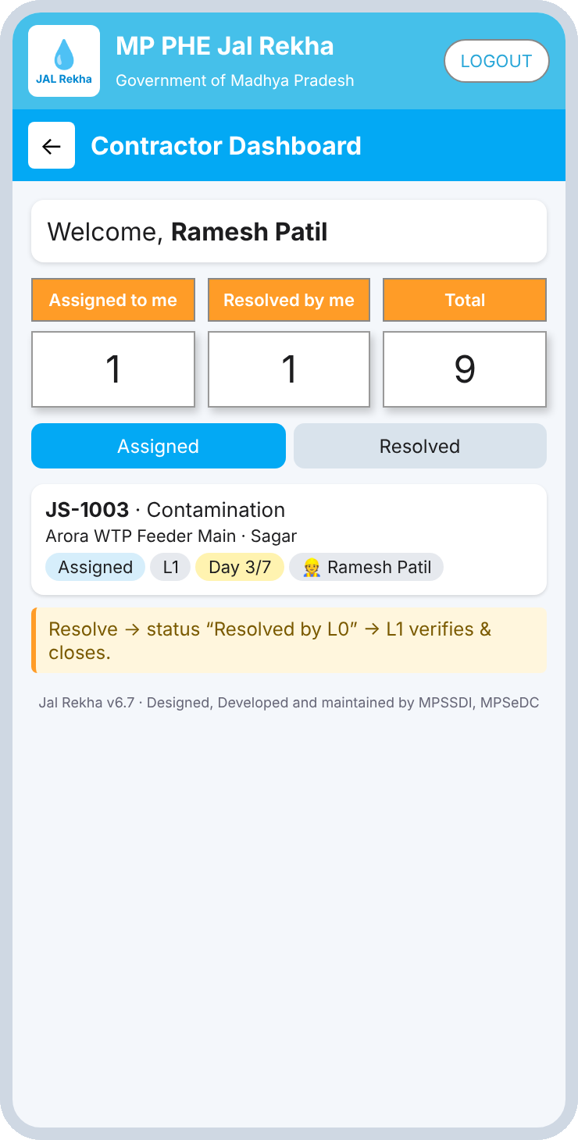
Department login and contractor verification
L0
What happens here
Login: username or mobile, password, OTP and captcha
Demo buttons jump straight to any role
Contractor verified by registered mobile; name shown to confirm
Dashboard: Assigned to me, Resolved by me, Total
Department login
L0 verification
L0 dashboard
Notes:
Department login has role shortcuts for the demo. Contractors are verified by registered mobile number.

Slide 15
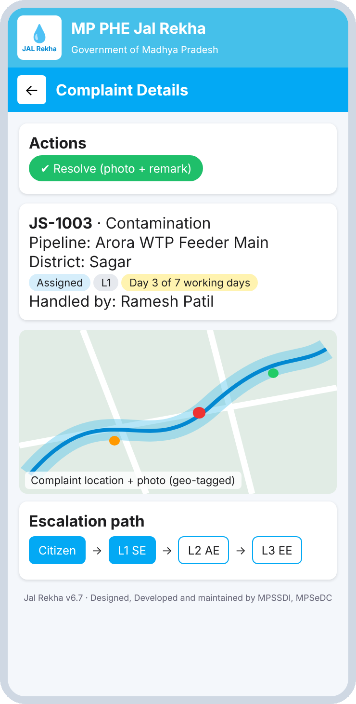
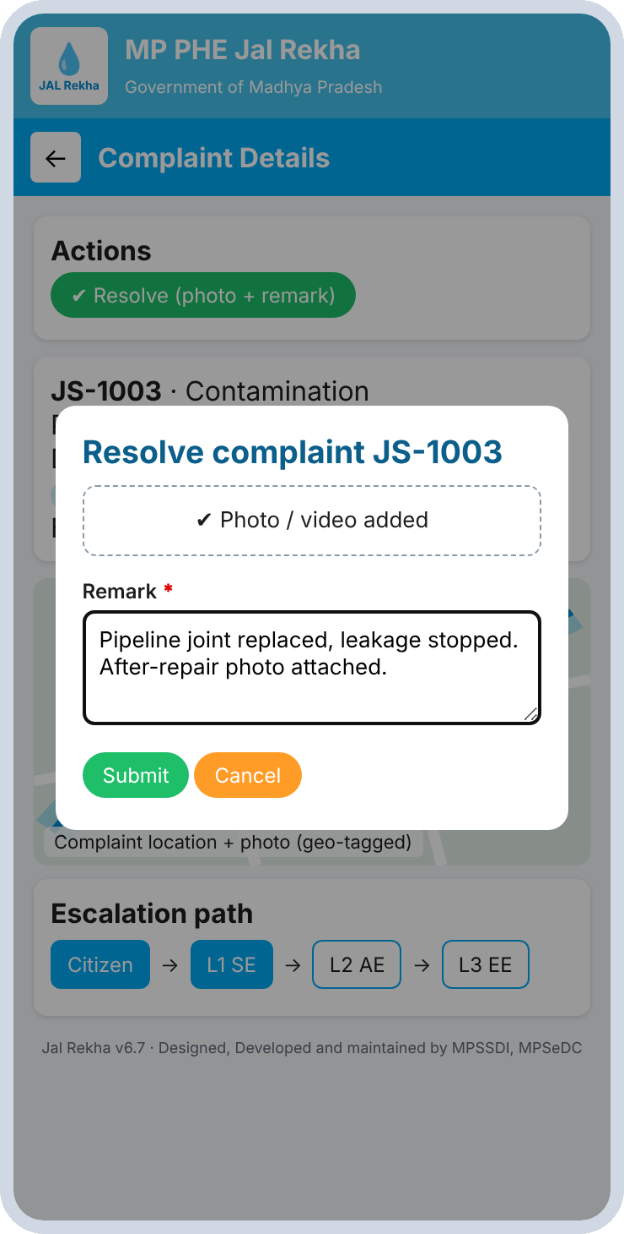
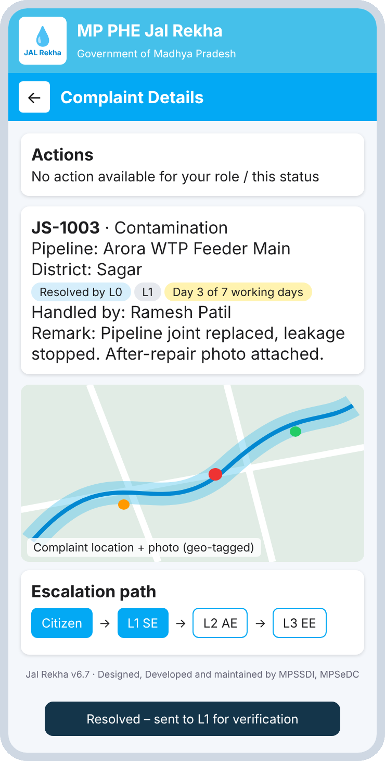
L0 contractor: resolve with proof
L0
What happens here
Open a complaint assigned by L1 or L2
Resolve needs an after-repair photo and a remark
Status becomes Resolved by L0
L1 then verifies and closes
Assigned complaint
Photo and remark
Sent to L1
Notes:
Resolve needs an after-repair photo and a remark; status moves to Resolved by L0.

Slide 16
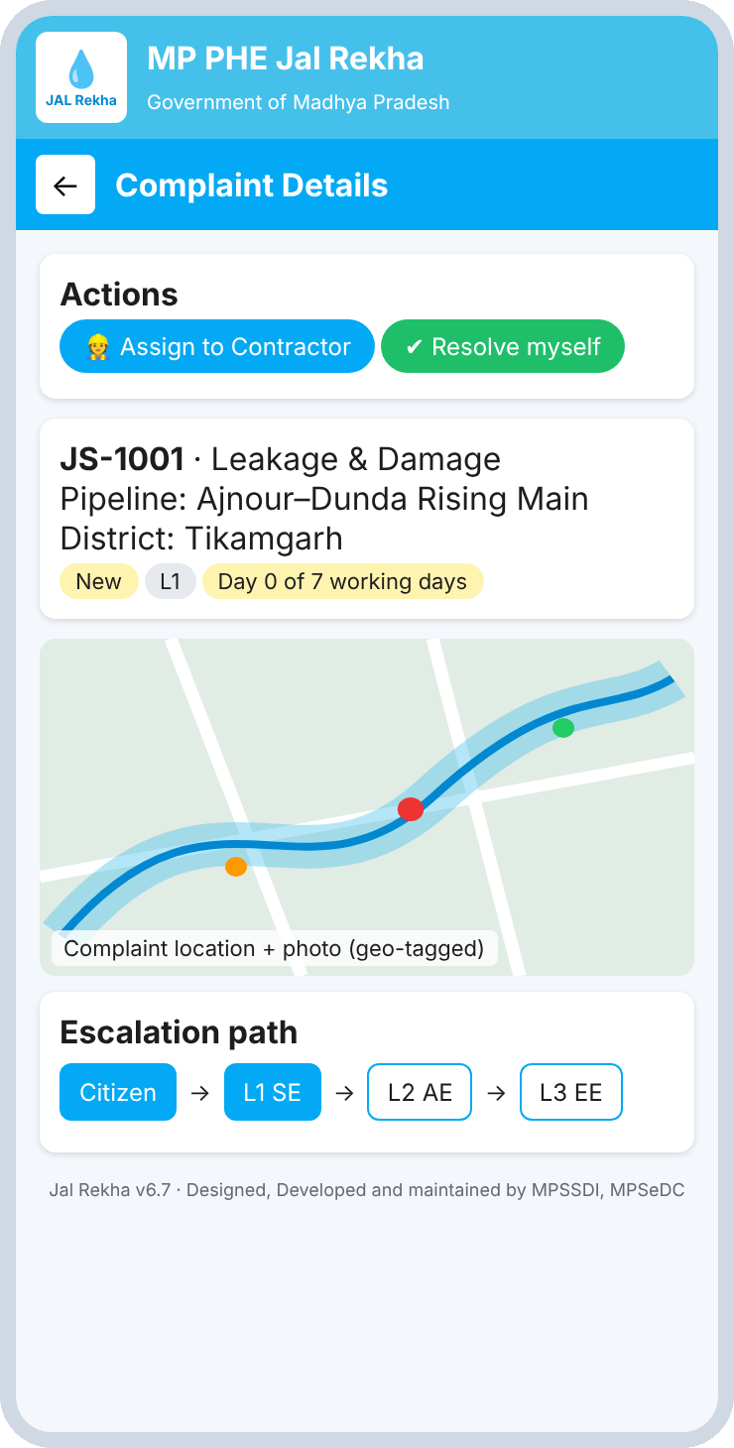
L1 (SE) dashboard and complaint detail
L1
What happens here
Counters: New / Reopened, With Contractor, Closed
Shortcuts to pipeline list and pipeline map
Tabs: New, With Contractor, To Verify, Closed
Detail shows role-based actions, a geo-tagged map and the escalation path
L1 dashboard
Complaint detail with actions
Notes:
Actions appear at the top of the detail screen according to role and status.

Slide 17
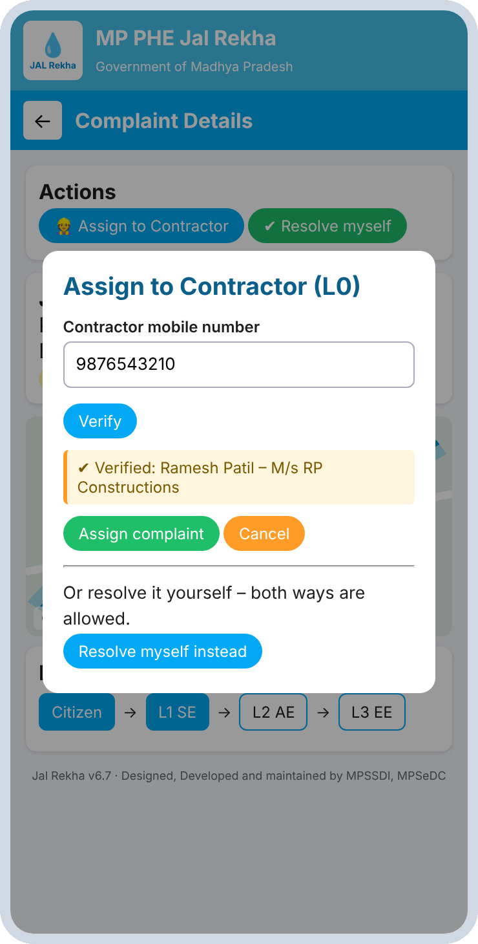
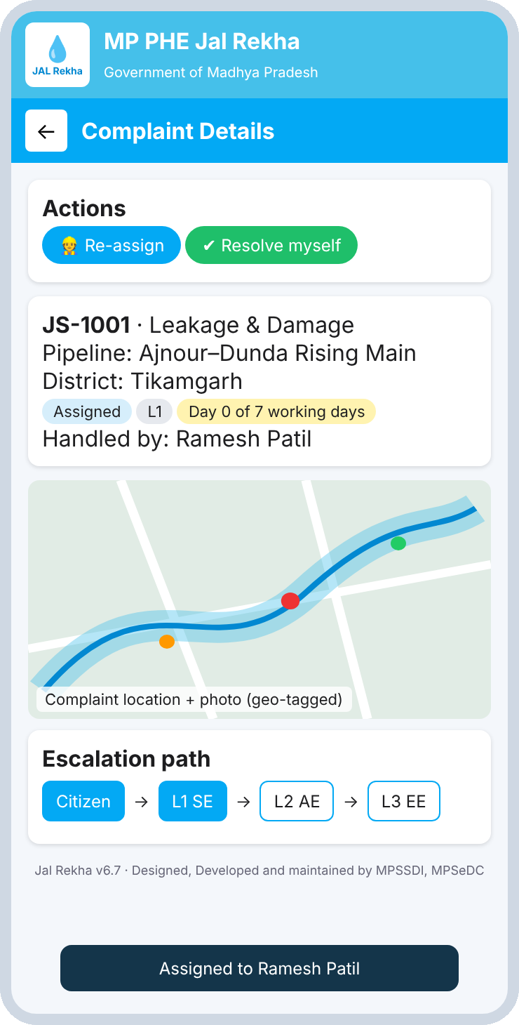
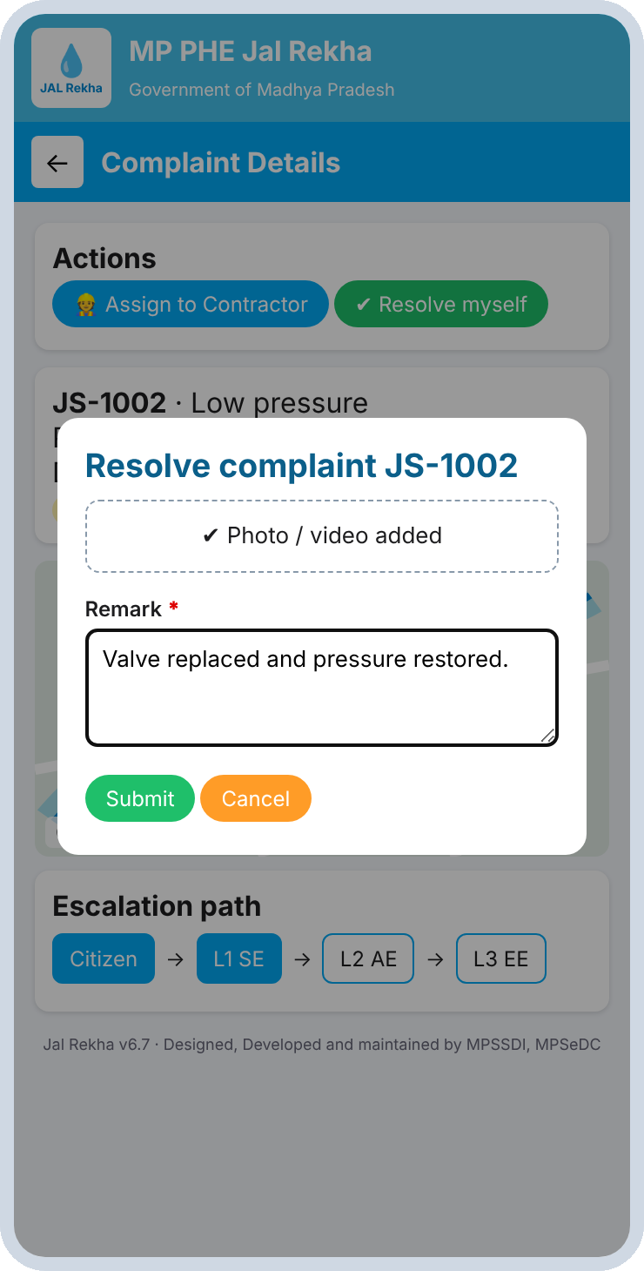
L1: assign to a contractor or resolve
L1
What happens here
Enter the contractor mobile, Verify shows the name, then Assign
Re-assign is possible while the complaint is with the contractor
Or resolve personally: photo and remark required
The same options apply to L2
Assign: verify mobile
Assigned
Resolve himself
Notes:
Both ways are allowed: assign to L0 or resolve personally.

Slide 18
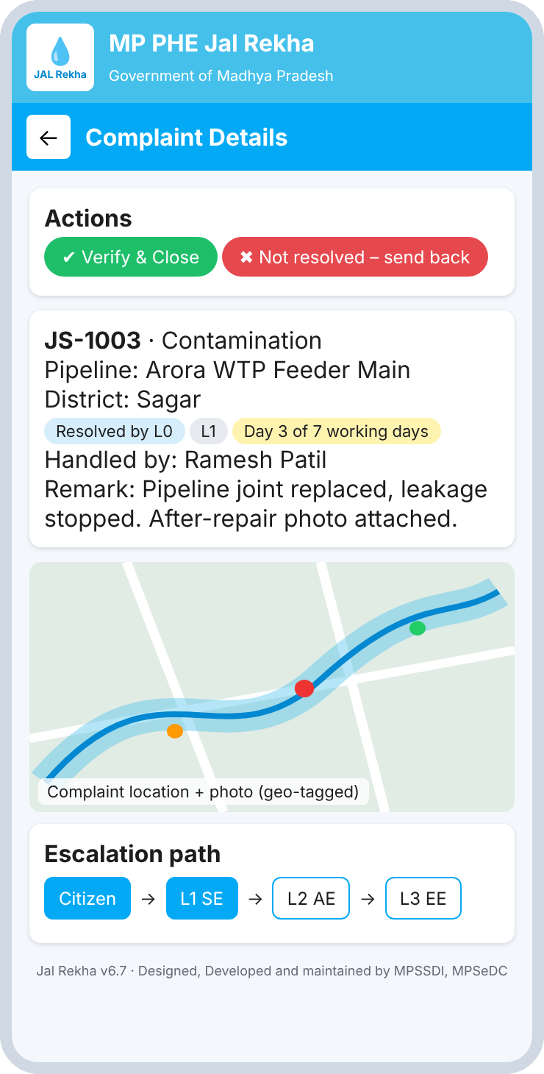
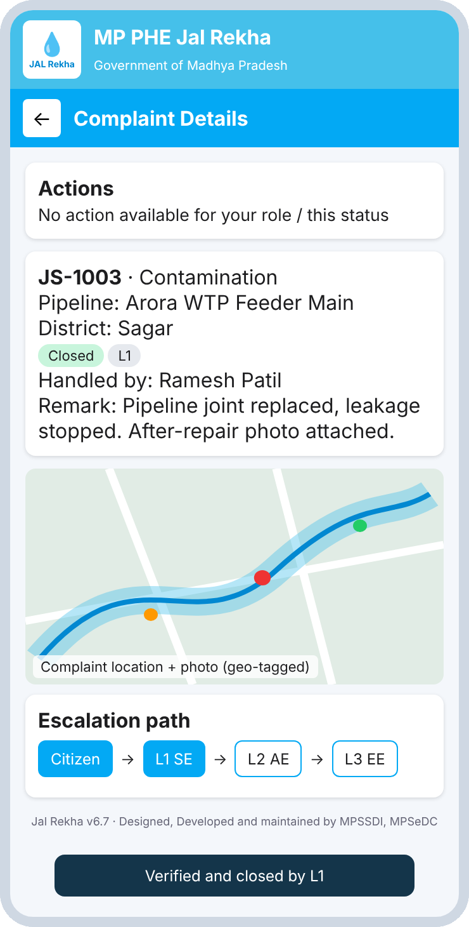
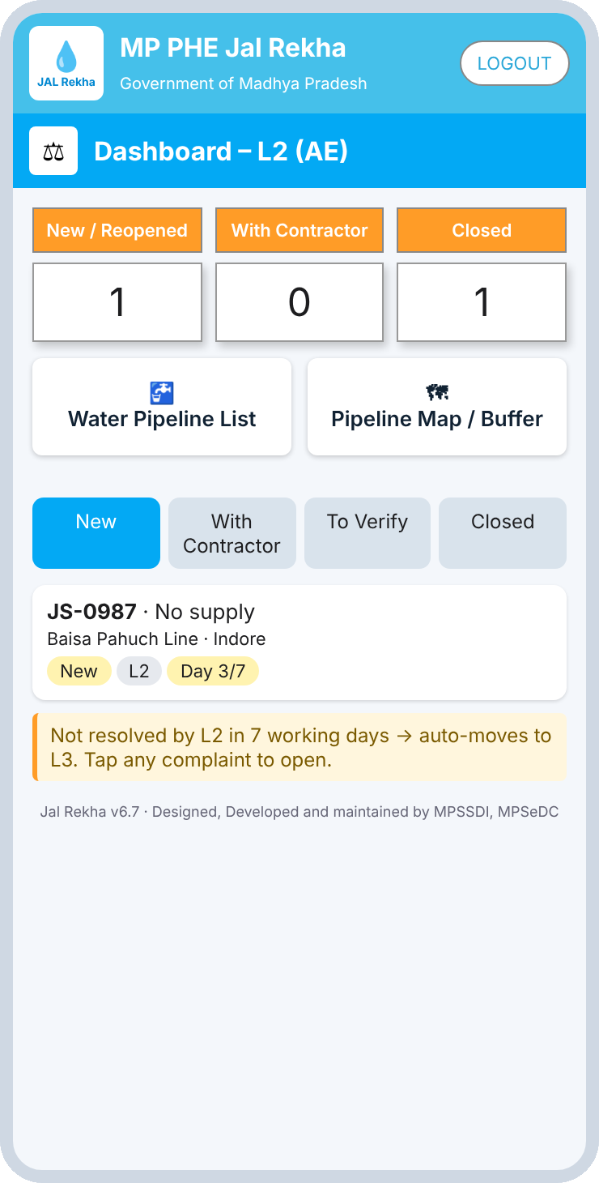
L1 verifies and closes; L2 mirrors L1
L1 · L2
What happens here
Contractor work waits in To Verify
Verify & Close, or send back as not resolved
Closed complaints appear on the L3 dashboard
L2 sees escalations from L1 with the same actions
To verify
Verified and closed
L2 (AE) dashboard
Notes:
Contractor-resolved complaints wait in To Verify. L2 receives escalations with the same actions.

Slide 19
Monitoring and summary
SECTION C
L3 (EE) oversight on web and mobile, plus the workflow summary.

Slide 20
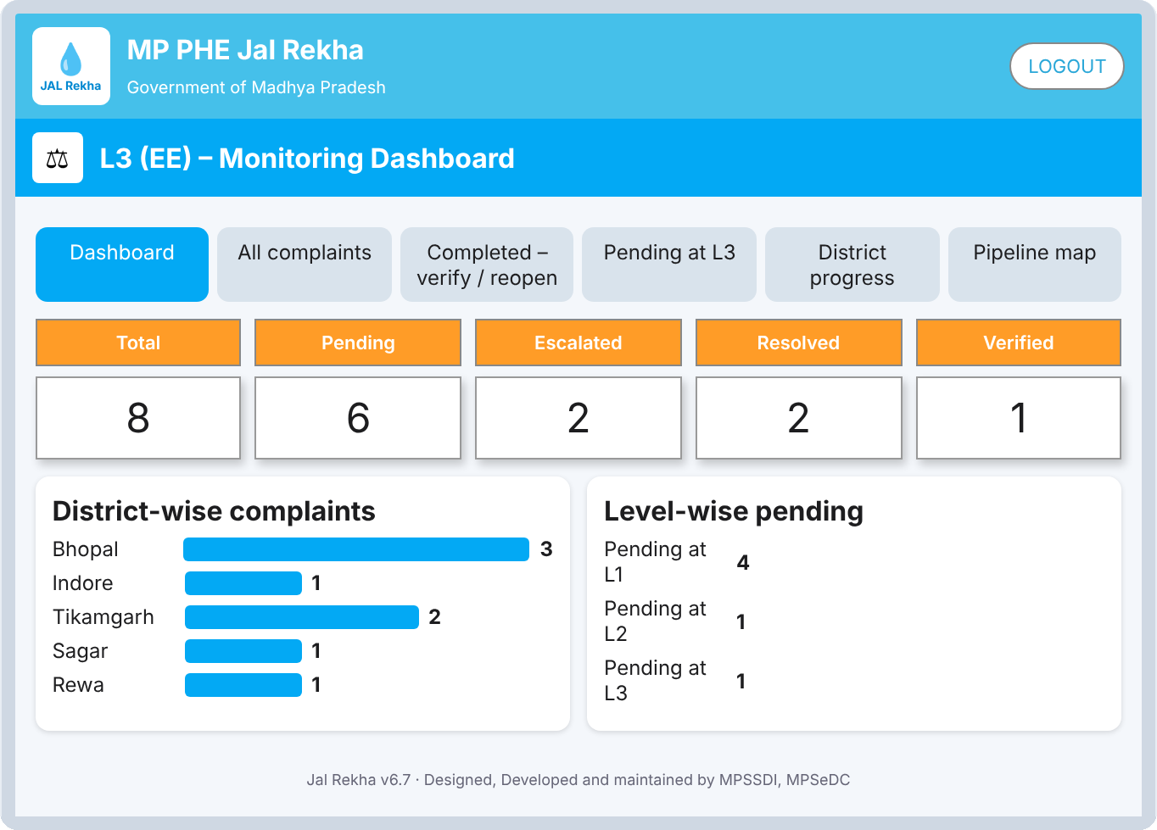
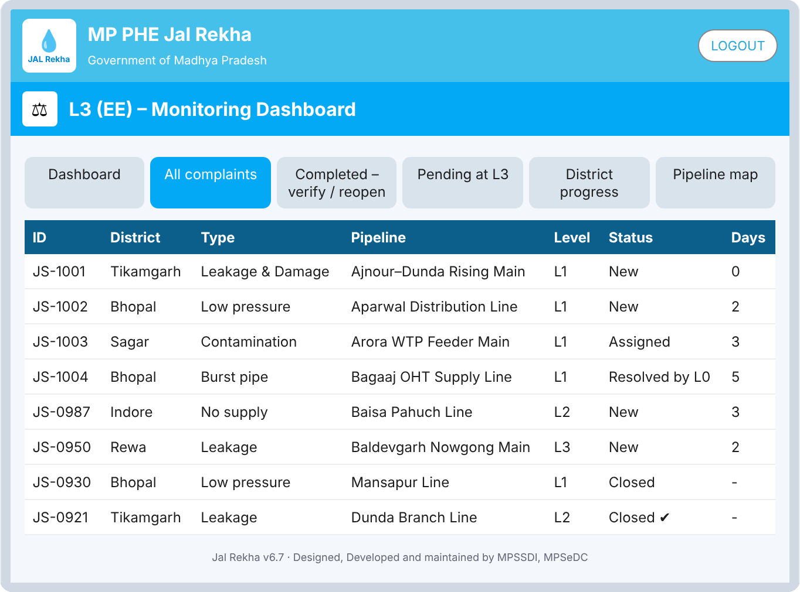
L3 (EE) web: dashboard and all complaints
Dashboard tab
Totals, district-wise bars and level-wise pending
All complaints
ID, district, type, pipeline, level, status and days
Notes:
The L3 web dashboard has six tabs. These are the first two.

Slide 21
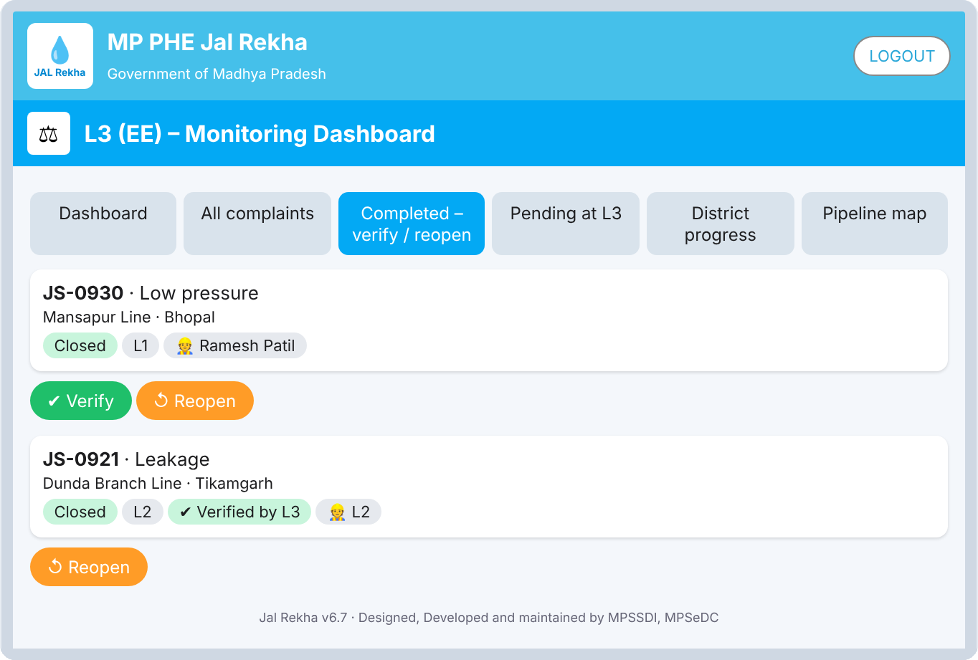
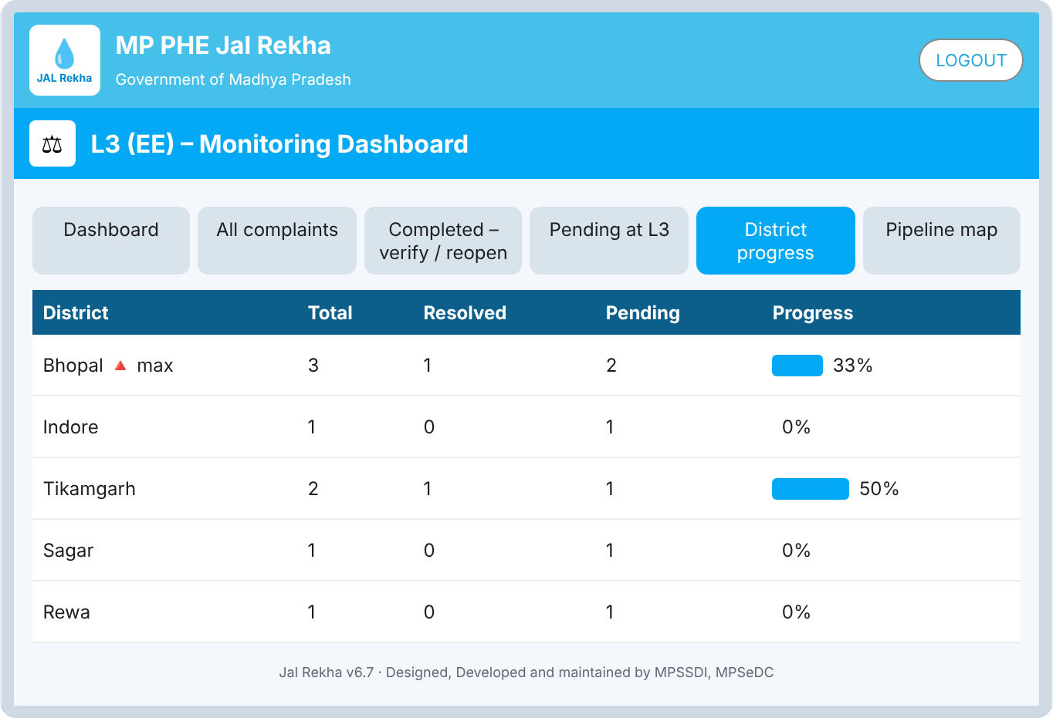
L3 web: completed work and district progress
Completed: verify / reopen
L3 verifies closed work or reopens it to L1
District progress
Total, resolved, pending and % progress per district
Notes:
Completed complaints can be verified or reopened. District progress flags the district with the most complaints.

Slide 22
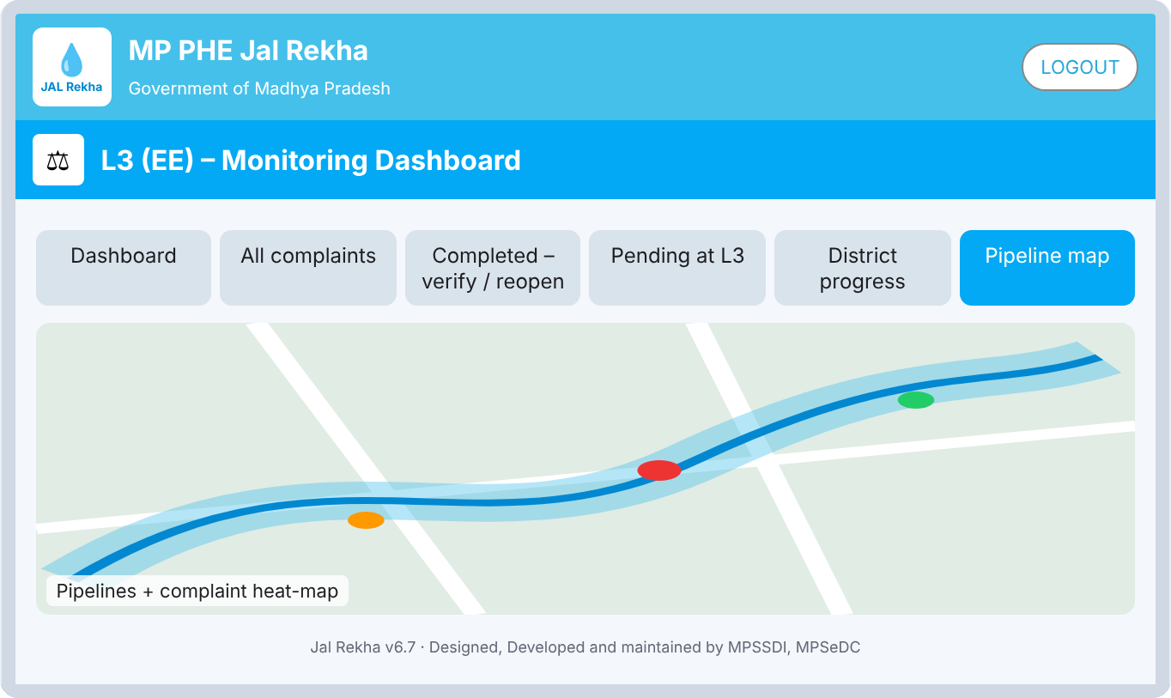
L3 web: pipeline map
L3
What happens here
Six web tabs: Dashboard, All complaints, Completed
Pending at L3, District progress, Pipeline map
Map overlays pipelines with a complaint heat-map
The district with the most complaints is flagged
Pipeline map tab
Pipelines and complaint heat-map
Notes:
Pipelines plus a complaint heat-map. The same map is available on L3 mobile.

Slide 23
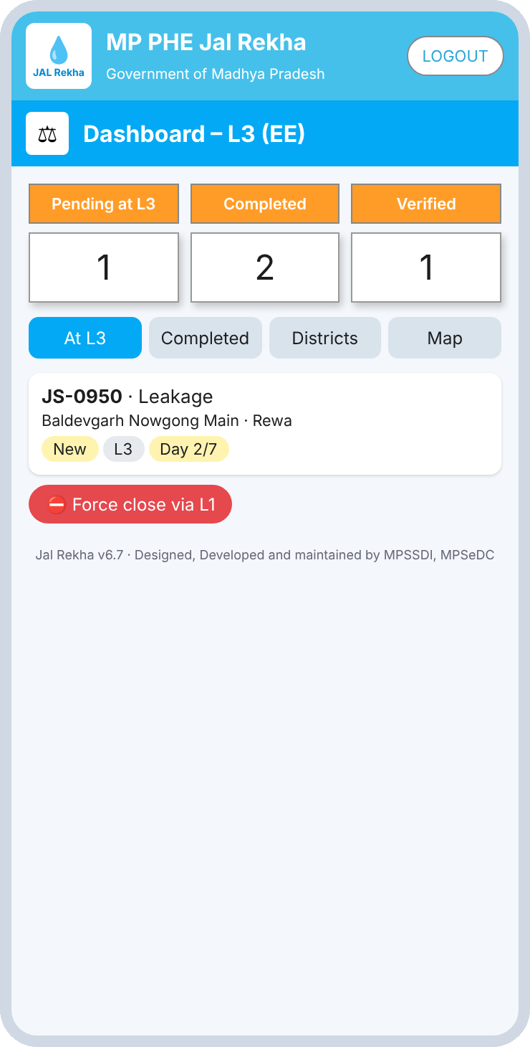
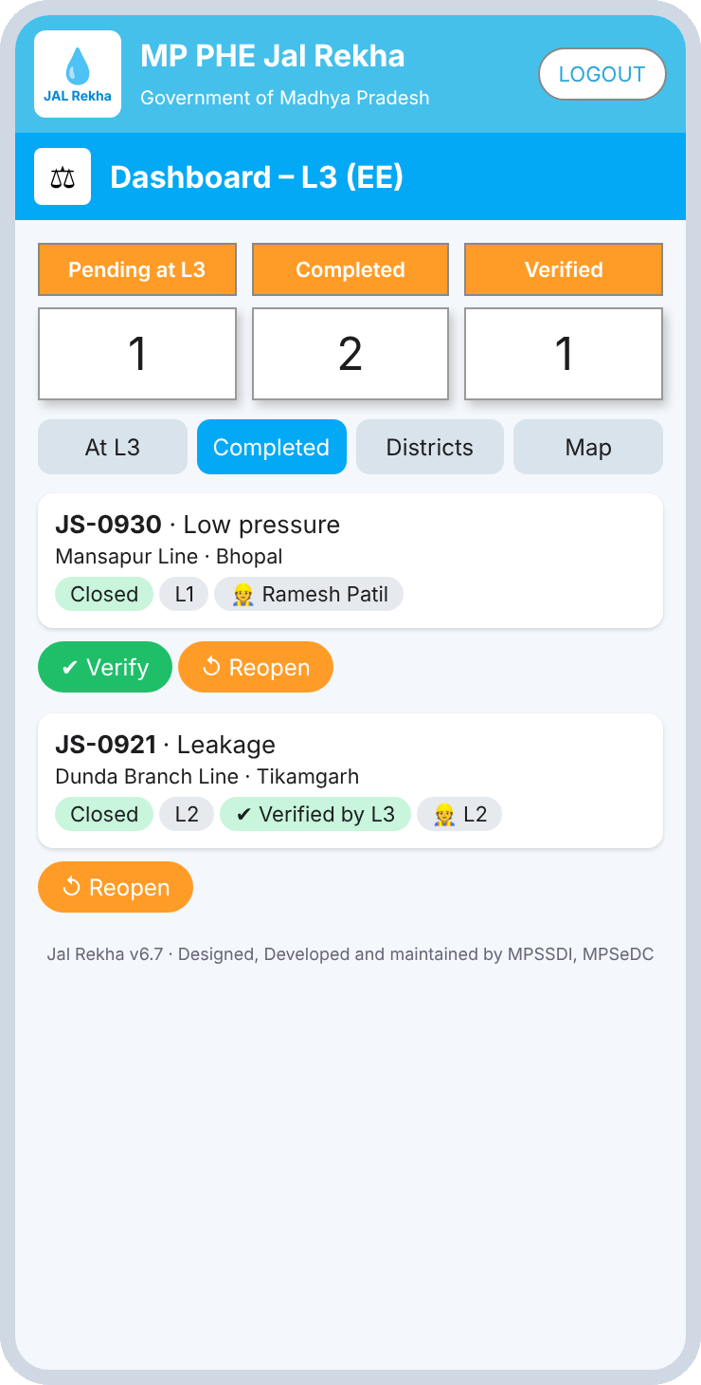
L3 (EE) on mobile
L3
What happens here
Counters: Pending at L3, Completed, Verified
Tabs: At L3, Completed, Districts, Map
Quick Verify or Reopen straight from the list
Verified items are tagged Verified by L3
Pending at L3
Completed tab
Notes:
Mobile L3 for quick verify and reopen.

Slide 24
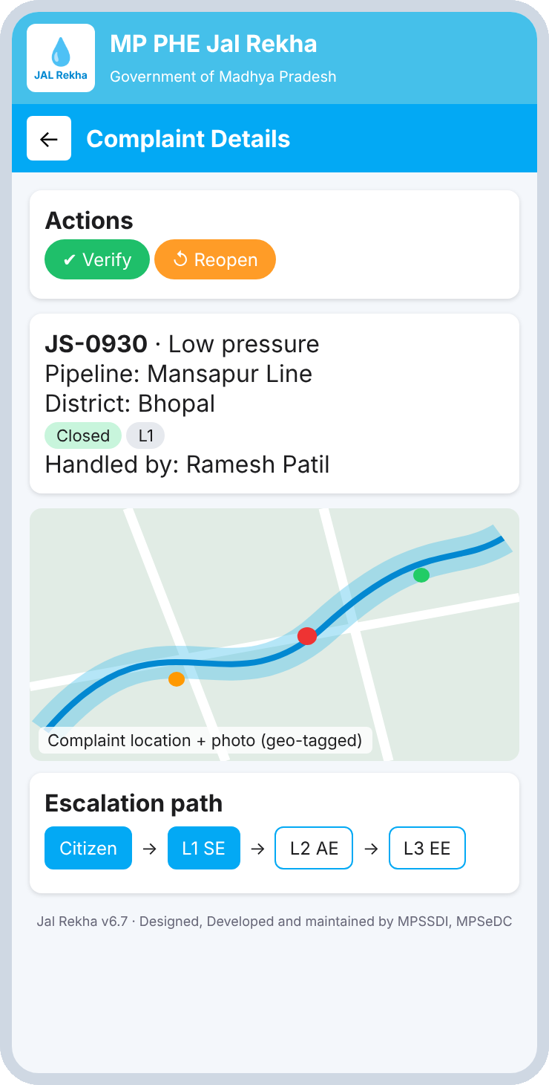
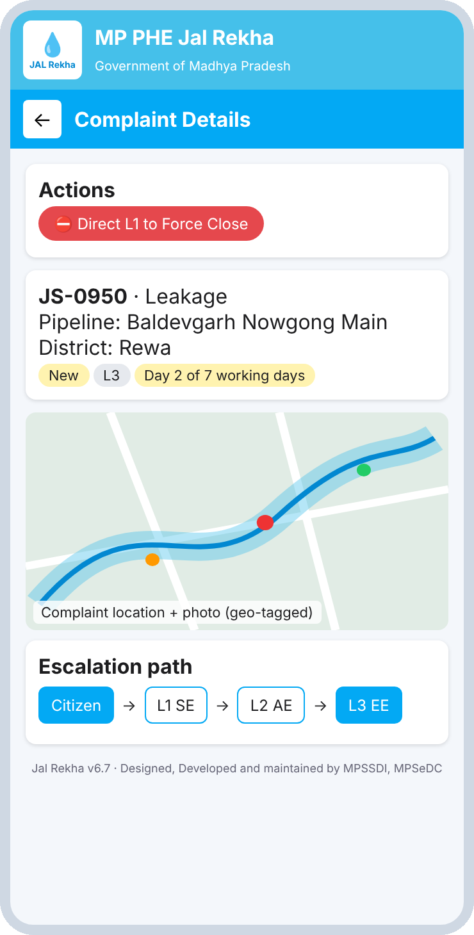
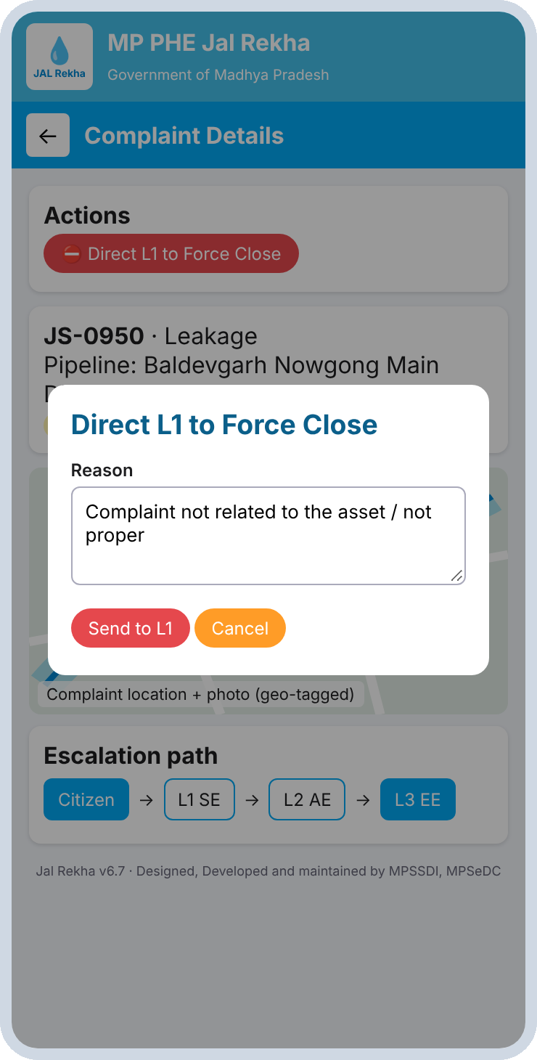
L3 actions: verify, reopen, force close
L3
What happens here
Completed: Verify, or Reopen back to L1
Open: Direct L1 to Force Close
Force close takes a reason, such as not related to the asset
The escalation path highlights where the complaint sits
Completed complaint
Open complaint at L3
Force close reason
Notes:
Actions depend on whether the complaint is completed or still open.

Slide 25
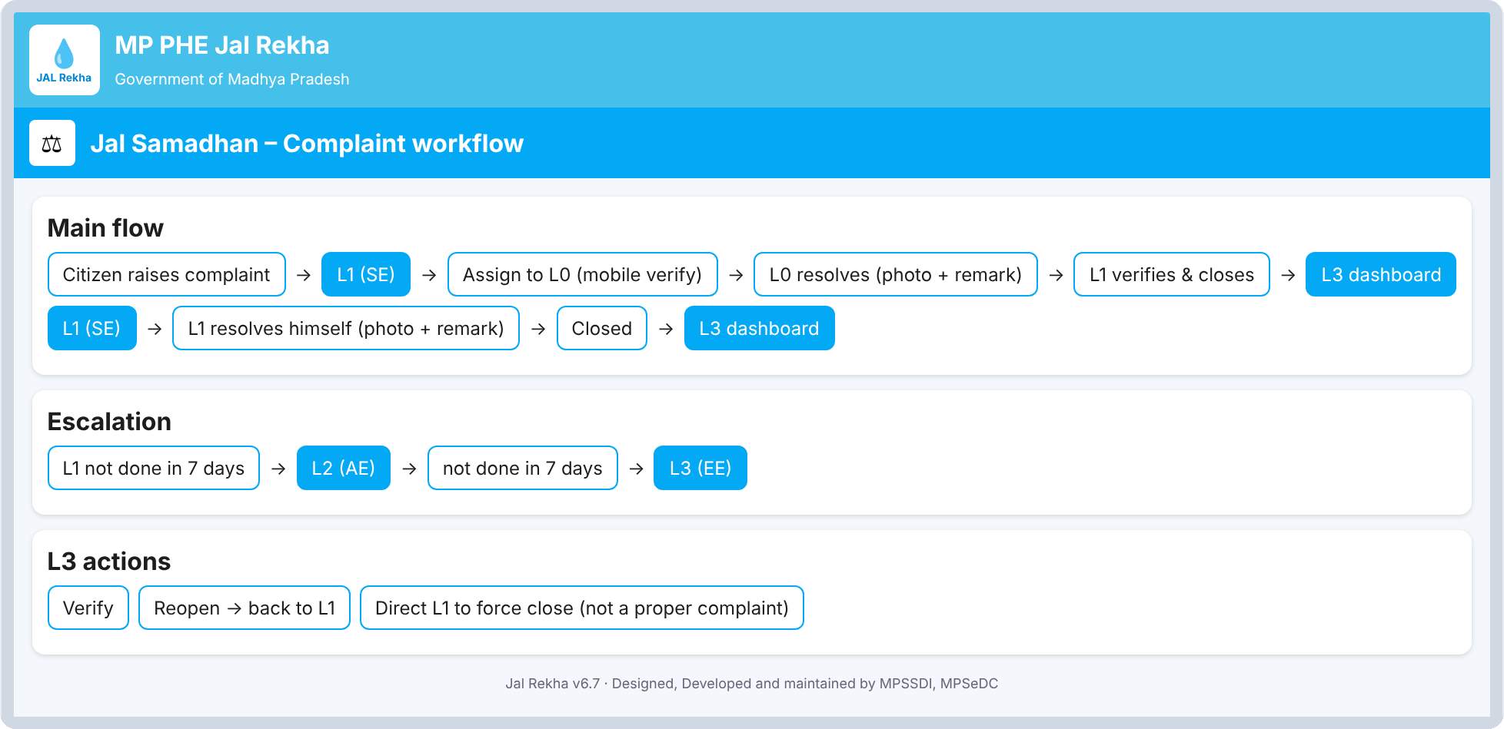
The wireframe's workflow summary
Main flow, direct fix, escalation and L3 actions. Editable in the wireframe edit mode.
Notes:
This is the editable workflow summary screen inside the wireframe.

Slide 26
Screen inventory
Public and citizen · 9 screens
Department and shared · 9 screens
Screen | Role | Device
Public dashboard | Public | Web
Select user type | Public | Mobile
Register / login citizen | Citizen | Mobile
Citizen home | Citizen | Mobile
Register new complaint | Citizen | Mobile
My complaints / status | Citizen | Mobile
List of water pipelines | Citizen | Mobile
Pipeline route + buffer map | Citizen | Mobile
Feedback and SOS | Citizen | Mobile
Screen | Role | Device
Department login | L0 to L3 | Mobile
L0 contractor login | L0 | Mobile
L0 dashboard | L0 | Mobile
L1 (SE) dashboard | L1 | Mobile
L2 (AE) dashboard | L2 | Mobile
L3 (EE) dashboard | L3 | Web
L3 (EE) dashboard | L3 | Mobile
Complaint detail (role based) | All roles | Mobile
Workflow summary | All roles | Web
Notes:
All 18 screens in the wireframe, grouped by who uses them.

Slide 27
Points to confirm before development
SOS contact numbers
The helpline (1800-XXX-XXXX) and district control room numbers are placeholders.
1
Contractor directory and OTP
Demo mobile numbers and the on-screen captcha are mock data. A real contractor master and OTP service are needed.
2
Escalation clock
Confirm the 7 working-day rule (holiday calendar) applies the same at L1 and L2, and when the counter restarts.
3
Pipeline buffer
The wireframe validates complaint location with a 10 m buffer. Confirm the width per pipeline type.
4
Public dashboard metrics
Average resolution time (4.2 days) is a fixed figure in the wireframe. Define how it is calculated.
5
Notes:
Items the wireframe leaves as placeholders or mock data.

